Slide 1
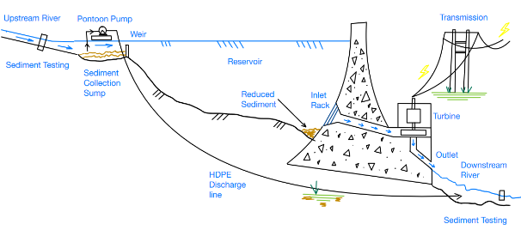
CAI3SP
STUDENT PITCH
NCP01 - G15
NCP MIRI 01
NOV 28 – DEC 09
A Sustainable Proposal for Sediment Bypass in Existing Hydroelectric Plants Jamie Attree Jacob Boon Matthew Cleminson Taylor Brown
PEOPLE
people-centred
PEDAGOGY
globally-placed
PRACTICE
paradigm-shifters
CRICOS Provider Code 00301J
Notes:
CA-I3SP has been the first Curtin mobility program to provide students with the important triple “I” experience of an international interdisciplinary industry-focused research study.

Slide 2
A Sustainable Proposal for Sediment Bypass in Existing Hydroelectric Plants
Original Team:
Jamie Attree Jacob Boon Taylor Brown Matthew Cleminson
Presenting Today:
Jamie Attree Jacob Boon
Matthew Cleminson
23/03/2023
Group 15

Slide 3
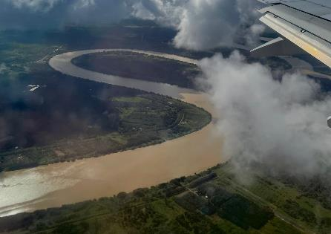
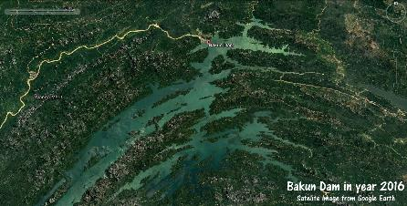
Overview of Hydroelectric Plants (HEP) – Impacts & Issues
50-100* year lifespan
Huge environmental & Social impact
Damaged by sedimentation
Build up of organic matter
Reduces lifespan by up to 50%
Sarawak’s HEP’s are greatly effected
Credit: Nathaniel Brown

Slide 4
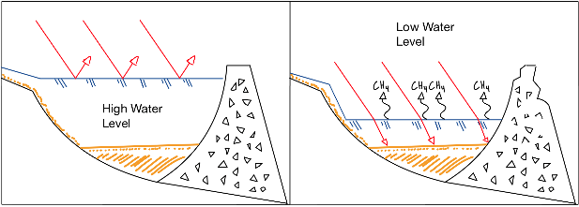
Environmental Impact of Sedimentation
Sedimentation causes:
Reduction of top soil
Reduction of reservoir capacity
Considerable methane emission upon decommissioning
Bakun takes in 9,000,000 tonnes annually
CH₄ + NH₄ + CO₂
Anerobic (No O₂₎
Light
Organics
Heat
Aerobic (O₂)
NO_{x} + SO_{x} + H₂O + CO₂

Slide 5
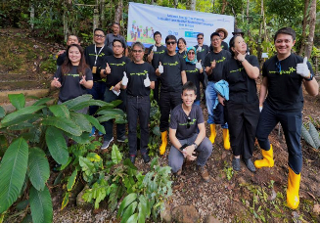
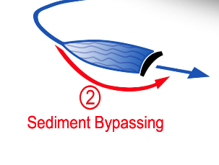
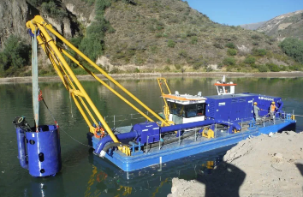
Current Solutions
Reduce Sediment Flow
Afforestation
Re-route Sediment
Reservoir Bypass
Remove Sediment
Dredging
Notes:
The US department of Interior & US Army Corps of Engineers has identified the need to manage the impact of sediment in a more sustainable manner utilizing fewer resources in Hydro dams.
Reduce sediment: - Afforestation:
By planting native species of plants and tress upstream to support sediment and reduce runoff.
Rerouting sediment - Sediment Bypass tunnel:
Limited to the initial design of hydro dams and therefore must be planned for prior to the commencement of construction.
Remove Sediment - Dredging:
Involves the removal of sediment that is stationary in the Hydro dam reservoir and its permanent relocation.

Slide 6
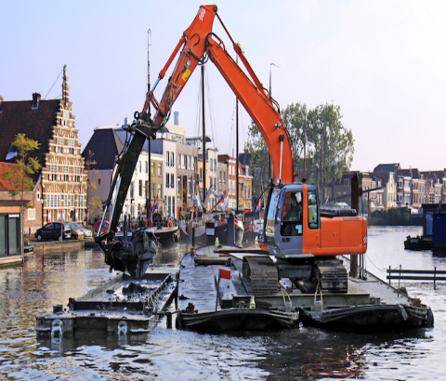
Dredging
Dredging is the removal of sediment by mechanical means
High equipment and labour costs
Depth limitations
High CO₂ emissions
Need to relocate sediment
Notes:
· Dredging most used method of sediment control in the US
· Equipment and labor costs are high and recurring
· There is a need to continue dredging as the sediment will continue to refill reservoirs.
· Use of fossil fuels such as diesel for operation
· Limitations of depths greater than 100 Meters
· Impacts communities and ecosystems downriver

Slide 7
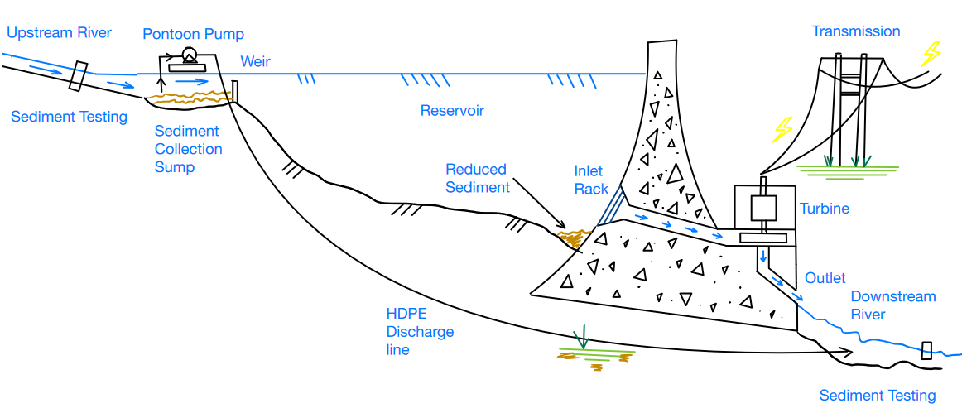
Sediment Bypass System – Schematic Diagram
Notes:
Watershed located at the mouth of the upstream river.
We propose utilisation of a sediment sump and weir (thickening process)
Weir could be constructed from: sheet piles, or submerged gabion wall (more sustainable)
Floating pontoon pump or turret pump localised to sump (submerged HDPE suction line)
HDPE discharge pipe orientated towards downstream outlet for re-introduction to river flow, Could be routed around external periphery of reservoir
Optical laser diffraction sensor, both upstream and downstream, which talk to a PLC to control flow rate of sediment to mimic the upstream natural fluctuations.

Slide 8
Sediment Bypass System – Pre feasibility Assessment
Description | Value | Units
River in/out flowrate | 264 | m³/s
Sediment Inflow rate | 193 | t/h
Solids Throughput | 193.5 | t/h
Liquid Throughput | 290 | t/h
Slurry Flow rate | 398 | m³/h
Solids S.G. | 1.80
Liquid S.G. | 1.00
Concentration by Weight (%w/w) | 40.00%
Slurry S.G. | 1.216
Concentration by Volume (%v/v) | 27.03%
P80 | 50 | μm
Discharge Flow Rate | 397.7 | m³/h
Description | Value | Units
Pump Efficiency | 60%
Shaft Power | 12.2 | kW
Drive Efficiency | 94%
Motor Shaft Power | 12.9 | kW
Design Margin | 20%
Total Required Power | 16.2 | kW
Motor Selection | 30 | kW
Assumptions:
Discharge distance ~500m
Discharge elevation 10m
Power associated with one pump
Multiple pumps could be utilised on Pontoon for scalability purposes
Notes:
Watershed located at the mouth of the upstream river.
We propose utilisation of a sediment sump and weir (thickening process)
Weir could be constructed from: sheet piles, or submerged gabion wall (more sustainable)
Floating pontoon pump or turret pump localised to sump (submerged HDPE suction line)
HDPE discharge pipe orientated towards downstream outlet for re-introduction to river flow, Could be routed around external periphery of reservoir
Optical laser diffraction sensor, both upstream and downstream, which talk to a PLC to control flow rate of sediment to mimic the upstream natural fluctuations.

Slide 9
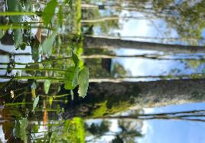
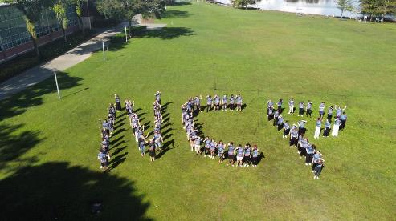
Favourite Experience
Jamie Attree
Short problem solving workshop at SMK Taman Tunku, a local high school. Was a very stark difference to the schools in Australia.
Jacob Boon
Appreciation of Malaysia and Borneo's challenges in balancing economic growth whilst not disrupting the natural environment
Enjoyed working with students from other faculties
Matthew Cleminson
Opportunity to:
Immerse myself in different cultures
Be empathetic of alternate opinions
Engage with industry and international stakeholders

Slide 10
Thank you for listening Questions?
Jamie Attree: Jamie.Attree@student.curtin.edu.au
Jacob Boon: Jacob.Boon@student.curtin.edu.au
Matthew Cleminson: Matthew.Cleminson@student.curtin.edu.au

