Slide 1
Workshop 10

Slide 2
Outcomes
Test
Bring prototype back to stakeholders and receive feedback on its usefulness
Using the Lean Canvas Model
Final editing of prototype and presentations

Slide 3
Test
The Test mode is when you solicit feedback, about the prototypes you have created, from your stakeholders and have another opportunity to gain empathy for the people you are designing for.
Testing tends to focus on the interaction with stakeholders, but don’t reduce your “testing” work to asking whether or not people like your solution.
Instead, continue to ask “Why?”, and focus on what you can learn about the person and the problem as well as your potential solutions.
A rule of thumb: always prototype as if you know you’re right, but test as if you know you’re wrong—testing is the chance to refine your solutions and make them better.
This Photo by Unknown Author is licensed under CC BY-ND

Slide 4
Why Test
To refine prototypes and solutions.
To learn more about your stakeholders.
To refine your perspective

Slide 5
How to test
Show don’t tell. Put your prototype in the user’s hands – or your user within an experience. And don’t explain everything (yet). Let your tester interpret the prototype.
1
Watch how they use (and misuse!) what you have given them, and how they handle and interact with it; then listen to what they say about it, and the questions they have.
2
Create Experiences. Create your prototypes and test them in a way that feels like an experience that your user is reacting to, rather than an explanation that your user is evaluating.
3
Ask users to compare. Bringing multiple prototypes to the field to test gives users a basis for comparison, and comparisons often reveal latent needs.
4

Slide 6
Dealing with Feedback
Listen
Remember the benefit of receiving feedback
Understand by asking questions such as: what could be improved? Was it easy to use? How often would you use it ?

Slide 7
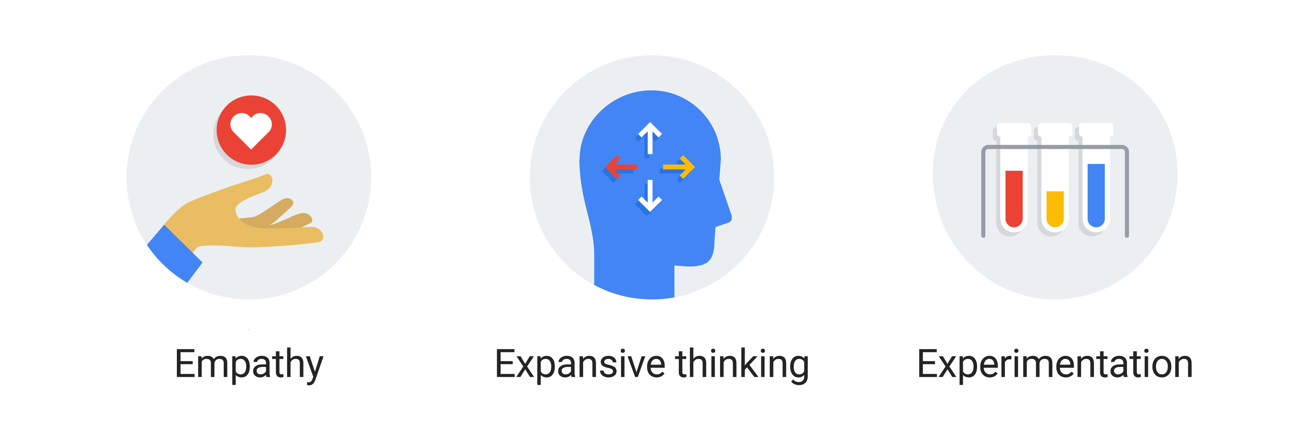
Reflecting
Notes:
Group discussion about
Empathy: how did their cultural experience influence their sense of empathy
Expansive thinking: How did testing the solution bring new insights
Experimentation: How did testing the solution reflect on their prototyping phase? Did they prototype enough? Did they look beyond the obvious solutions?

Slide 8
Final editing of prototype

Slide 9
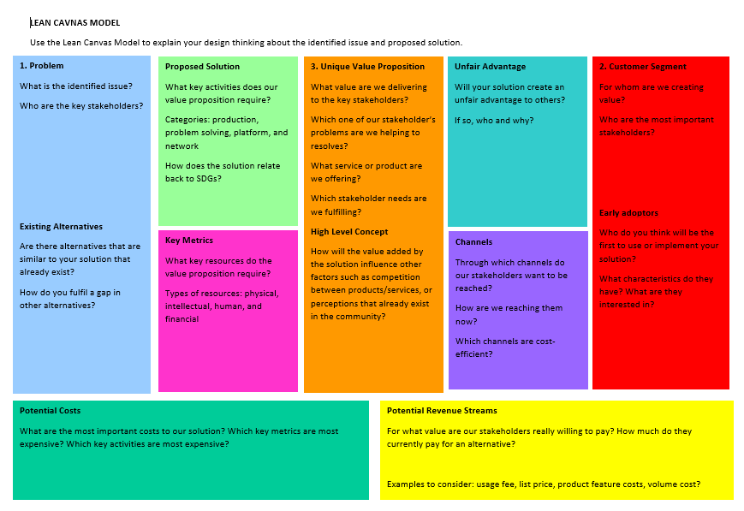
Lean Canvas Model

Slide 10
Presentation

